Slide 1
NoSQL Graph-Oriented Database to Store Accessible Transport Routes
Name : Aditi Paretkar
Roll no : 1911034
Batch : A3

Slide 2
Table of Contents
01
02
03
04
05
06
About The Paper
About NoSQL databases
Framework of the Project
Designing the Conceptual Data Model
Design of NoSQL Schema
Implementation& Conclusion

Slide 3
About the paper
Aim of the study:
Firstly , the study conducted aims to obtain more information on the current status of how information on accessible transport routes is available to those who require it
To create an open repository of accessible transport routes , through data derived from existing databases on transport routes and crowdsourcing
To make this data available to those requiring to use these transport routes , specifically to those with special needs
The authors aim to implement this study by the use of a NoSQL means – graphs , ER diagrams , etc.
About the Authors and premise of Publication :
The paper has been co –authored by the following authors and presented in Workshop Proceedings of the EDBT/ICDT 2018 Joint Conference in March 2018, in Vienna , Austria.
Belén Vela 2. José María Cavero 3. Paloma Cáceres 4. Almudena Sierra 5. Carlos Cuesta

Slide 4
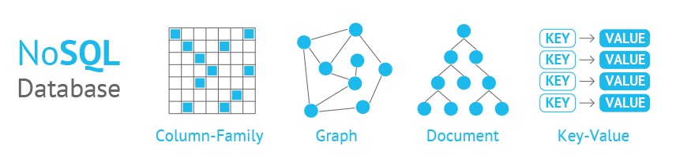
About NoSQL Databases
NoSQL database designs are used to model the data in a way that has not been modelled by using tables , such as graphs or key value pairs.
They provide the following advantages:
a. They allow us to store unstructured/ semi structured data
b. They allow easy updates to schemas and fields.
c. They can handle large volumes of data at a high speed using a scaled-out
architecture.

Slide 5
Flow of the Research Conducted
Purpose of the Study
How it has been conducted
According to the World Bank , nearly 15% of the world’s population falls under the ‘specially abled’ category.
The people who fall under this category require some type of special assistance in accessing information to public transport.
There have been several initiatives whose objective is to improve accessibility to public transport for people with disabilities.
This study has been carried out in order to analyse the websites and mobile applications that provide information regarding the accessibility of public transport
With regard to public transport users , they have identified six accessibility levels , and have grouped the data available into categories that target the person’s auditory , visual needs , among others.
With regard to public transport data , they have identified not only the quantity of information available , but also if it can be reused in the simple format from the web.
There are significant loopholes in the various websites that provide information regarding accessible journeys and service-based routing using public transport, due to lack of open and reusable data.
In order to address this, they have created a huge data repository under the Access@City Project that utilizes a NoSQL graph-oriented database.

Slide 6
Framework of the Project
Access@City Project
Gather data
Web Scraping
Crowdsourcing
Existing traffic sensors
Feed an open data repository with a service generation layer
SGL generates customized APIs for access to different users through mobile applications

Slide 7
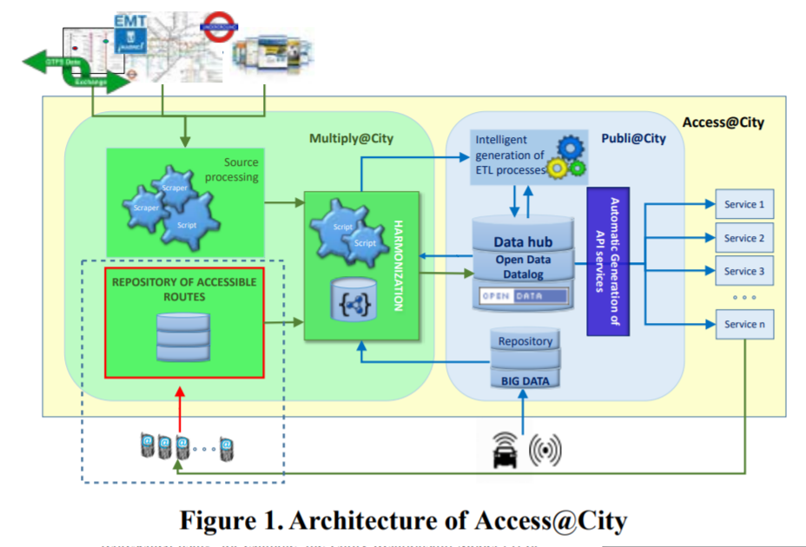
Construction of Framework
Steps Followed
Architecture
1. The framework of the paper rests on the
Access@City project whose aim is to define a technological framework for the processing, management and exploitation of open data with the goal of promoting accessibility to city public transport.
2. The project initially aims to create a huge data repository through data derived from three sources:
a. Existing open data obtained through web scraping.
b. Private data , obtained through crowdsourcing from users’ mobile applications, and processed using Big Data techniques
c. Data obtained from already existing traffic sensors , in the context of a smart city
3. The data is then semantically organized , and feeds an open data management system , that consists of a repository and a service generation layer.
4. The service generation layer is able to generate customized APIs for the consumers , for access to these transport routes through mobile applications

Slide 8
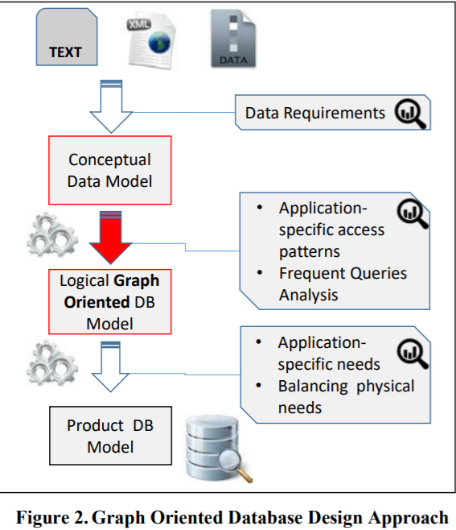
The next step: Designing the data model
After acquiring data the next step is to represent it using a NoSQL database, for this , as with any data model the following three schemas have been implemented:
Conceptual Schema: The data gathered , is analysed , so that the various entities, their attributes , and the relationships among them can be identified.
Logical Schema: This step is used to provide a structure to the conceptual data model elements , thus improving the maintainability of the NoSQL database.
Physical Schema: The translation of the above mentioned logical Schema into the final graph oriented /NoSQL database (which is the physical schema) is carried out using Neo4j , one of the most popular graph oriented database systems

Slide 9
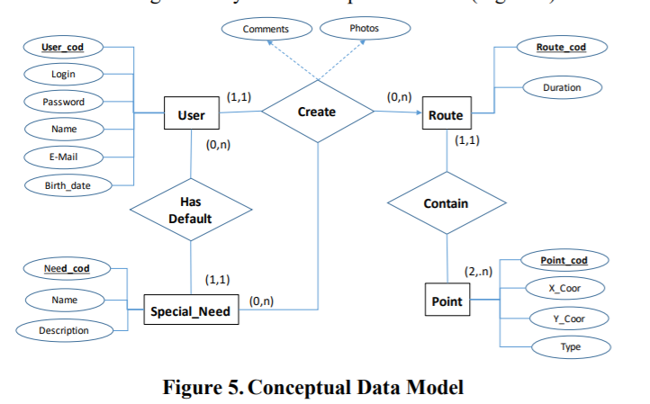
Application of the aforementioned schemas into designing an Application
Features of the Application
Step 1: Register/ Login by the user . This will create a USER Entity
Step 2: The special needs of the user are stored in the SPECIAL_NEED entity
Step 3: The user enters a at least two points of travel , a start point and an intermediate/ end point represented by X,Y coordinates , modelled by the POINT entity.
The application is connected to the database through the REST API.
In the conceptual data model , the ROUTE entity is made up of the POINT entities

Slide 10
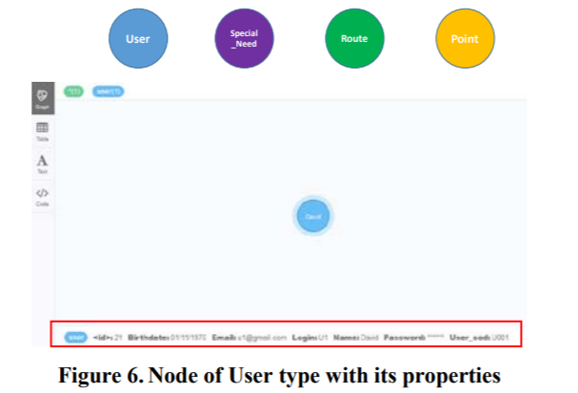
Conversion of Conceptual to Physical Data Model
In the paper , the Conceptual data model has been represented using an Entity relationship diagram while the Physical model has been represented using graphs. In the conversion of one data model to another , the following steps have been followed:
Each entity will be transformed into a node , and the constraints/ attributes of this entity will be transformed into the properties of the node

Slide 11
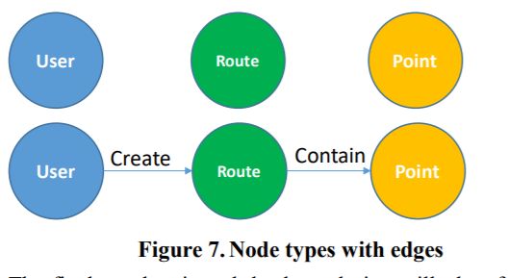
Conversion of Conceptual to Physical Data Model
Each relationship will, in general, be transformed into an edge between the nodes, depending specifically on the cardinality of the relationship. An arrowhead will be used to denote the ‘N’/’M’ side of the relation in one-many or many-many relations, such as 1:N or M:N . No arrowhead will be used in one-one relations
Removing of redundant entities : The properties of the SPECIAL_NEED entity , can be easily included as attributes of the USER entity , and thus it can be dropped .
final graph representation of the NoSQL database application

Slide 12
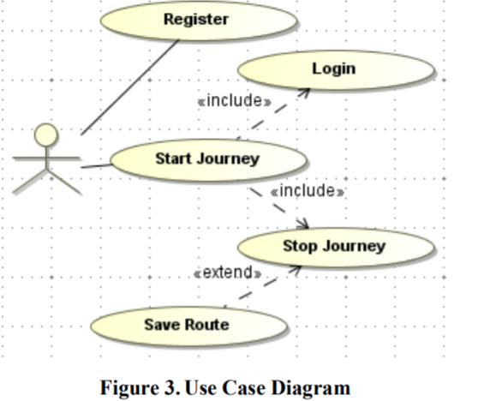
Creating a Sample Mobile Application from the data
The users will be allowed to register and create an account.
On traversing any route they wish , the user will have to enter the coordinates of travel , as well as their accessibility needs.
The users may search if any accessibility information is available on the route they wish to travel.
The users can also add new data including pictures and other accessibility information along their selected route , if not available.
Flowchart of application

Slide 13
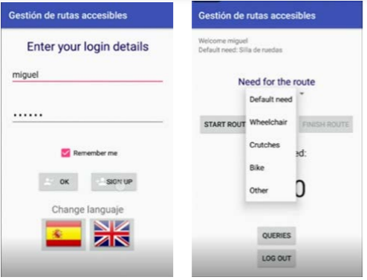
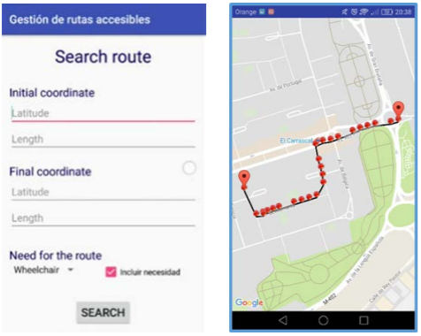
Few Screenshots from the application

Slide 14
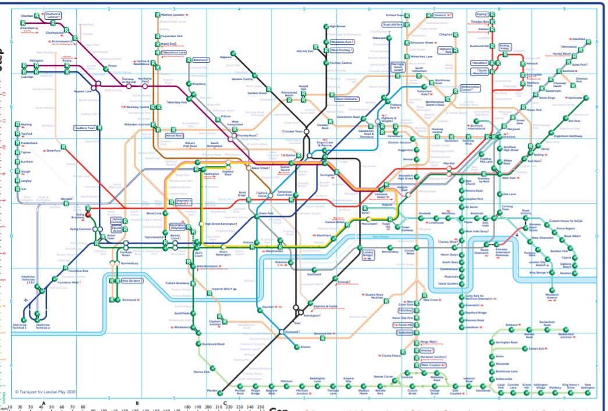
Implementation of paper
Steps to be taken
Shown alongside is a map of the London Tube(metro system ) that provides information regarding 4 kinds of accessibility information : wheelchair /step-free access, washrooms , elevators and accessible river services at any station.
2. We will be using the data provided through the map to identify different entities like station , accessibility service (1 entity for each) and line (as many lines pass through a station and on line goes to many stations).
3. We will then be creating nodes for each of the entities using Neo4j software to model them showing different relationships.
London Underground Map

Slide 15
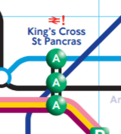
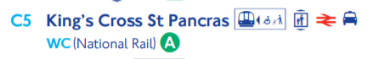
A small Example
Accessibility and travel information for King’s Cross St. Pancras
1. Shown Alongside is the travel information for the station Kings Cross St. Pancras that passes through the Circle, Piccadilly, Hammersmith & City, Northern, Metropolitan and Victoria lines.
2. It has wheelchair support as well as elevator services.
3. We would be creating an entity for the station showing a HAS-A relationship between the station and accessibility services and a PASSES-THROUGH relation between the station and the lines.
4. We can similarly model the remaining stations

Slide 16
Conclusion
The Authors have acknowledged the fact that document databases tend to have a dynamic schema , and thus it is important to design the NoSQL schema correctly .
However , no standard guidelines have as such been created that state the set of steps to be followed while implementing the NoSQL database.
Therefore , the authors have created their own set of guidelines for implementing the NoSQL database .
Using it , they have created an application whose data is sourced from a server that primarily operates on a graph-based schema, connected to the database using REST API .

Slide 17
Bibliography
Link to paper:
http://ceur-ws.org/Vol-2083/paper-10.pdf
2. Link to extended paper providing information on scraping data from transport websites for creating a graph based model
https://ieeexplore.ieee.org/stamp/stamp.jsp?arnumber=8782469
3. London Underground Map with accessibility information
http://content.tfl.gov.uk/step-free-tube-guide-map.pdf
4. Links to Neo4j resources:
https://neo4j.com/developer/get-started/
https://neo4j.com/blog/neo4j-video-tutorials/

Slide 18

Thank You!

